Slide 2
Music

Slide 3
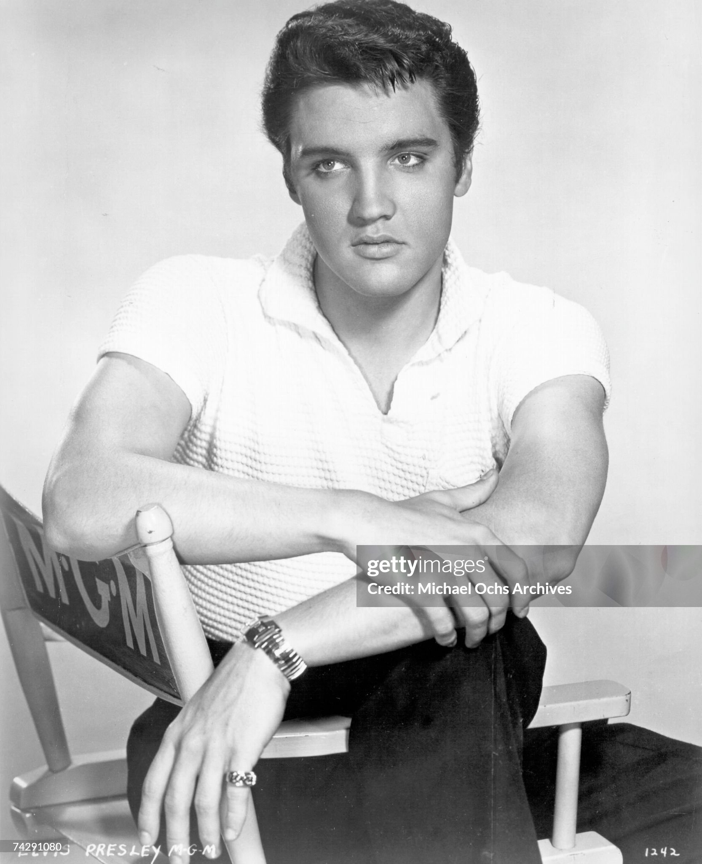
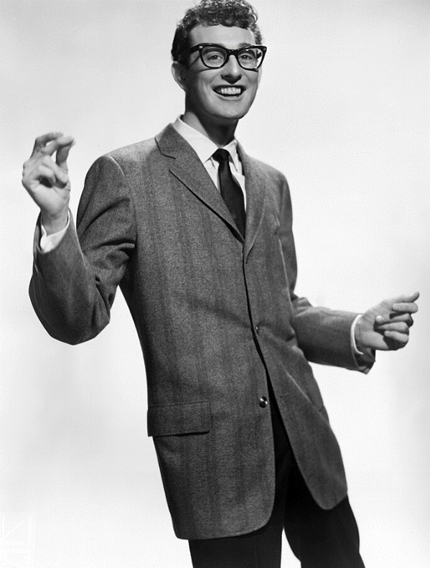
Rock and rollers 1856-1960
1950’s
Enter Rock and Roll
Buddy Holly,…falsetto
…happy youthful love
Elvis Presley….greased hair
…southern charm
…short sleeved shirts
….use of black gospel
Buddy Holly
Elvis Presley 1960
Changes 1959
“Day music died”:
Buddy plane crash..Elvis army
Shift to polished….”crooners”
….introduction of “Twist”
…processed….formulaic

Slide 4
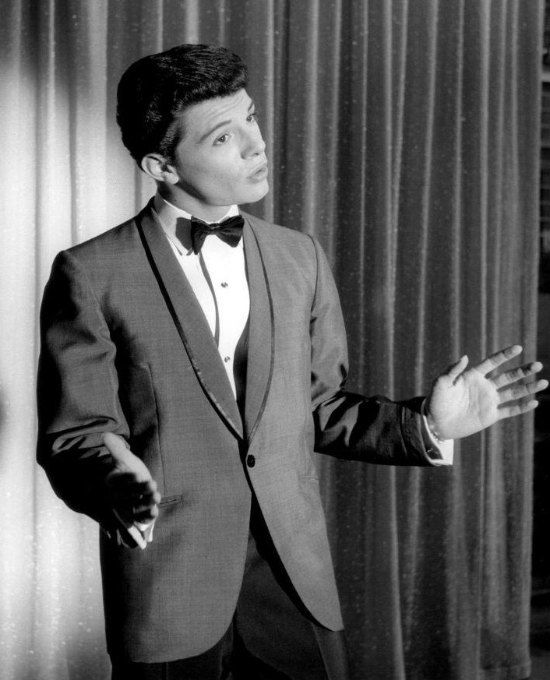
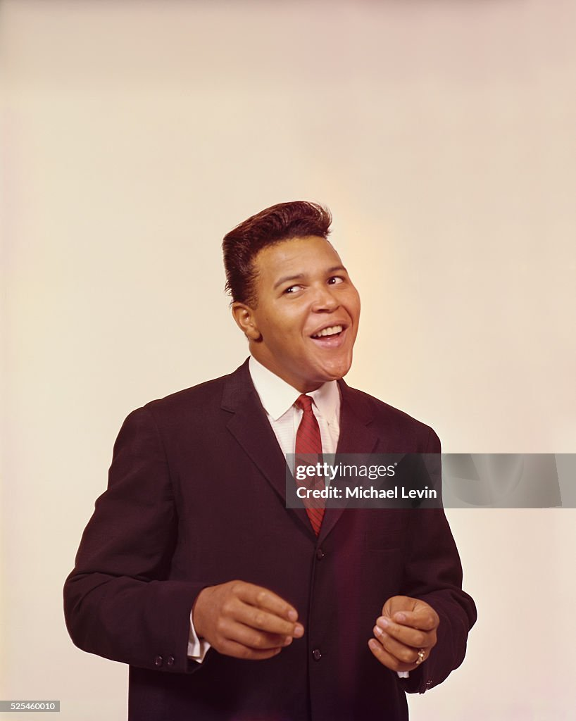
Crooners and Twisters 1960-1963
Chubby Checker
Teen idols: Pat Boone
Paul Anka, Frankie Avalon
…romantic
…teen love songs
Frankie Avalon
Fast dance music
..Chubby Checker
…Jerry Lee Lewis, Chuck Berry
Mass audience, radio
And tv…..safe, neat, all
American
Little innovation..
Singers replaceable
Big networks dominate

Slide 5
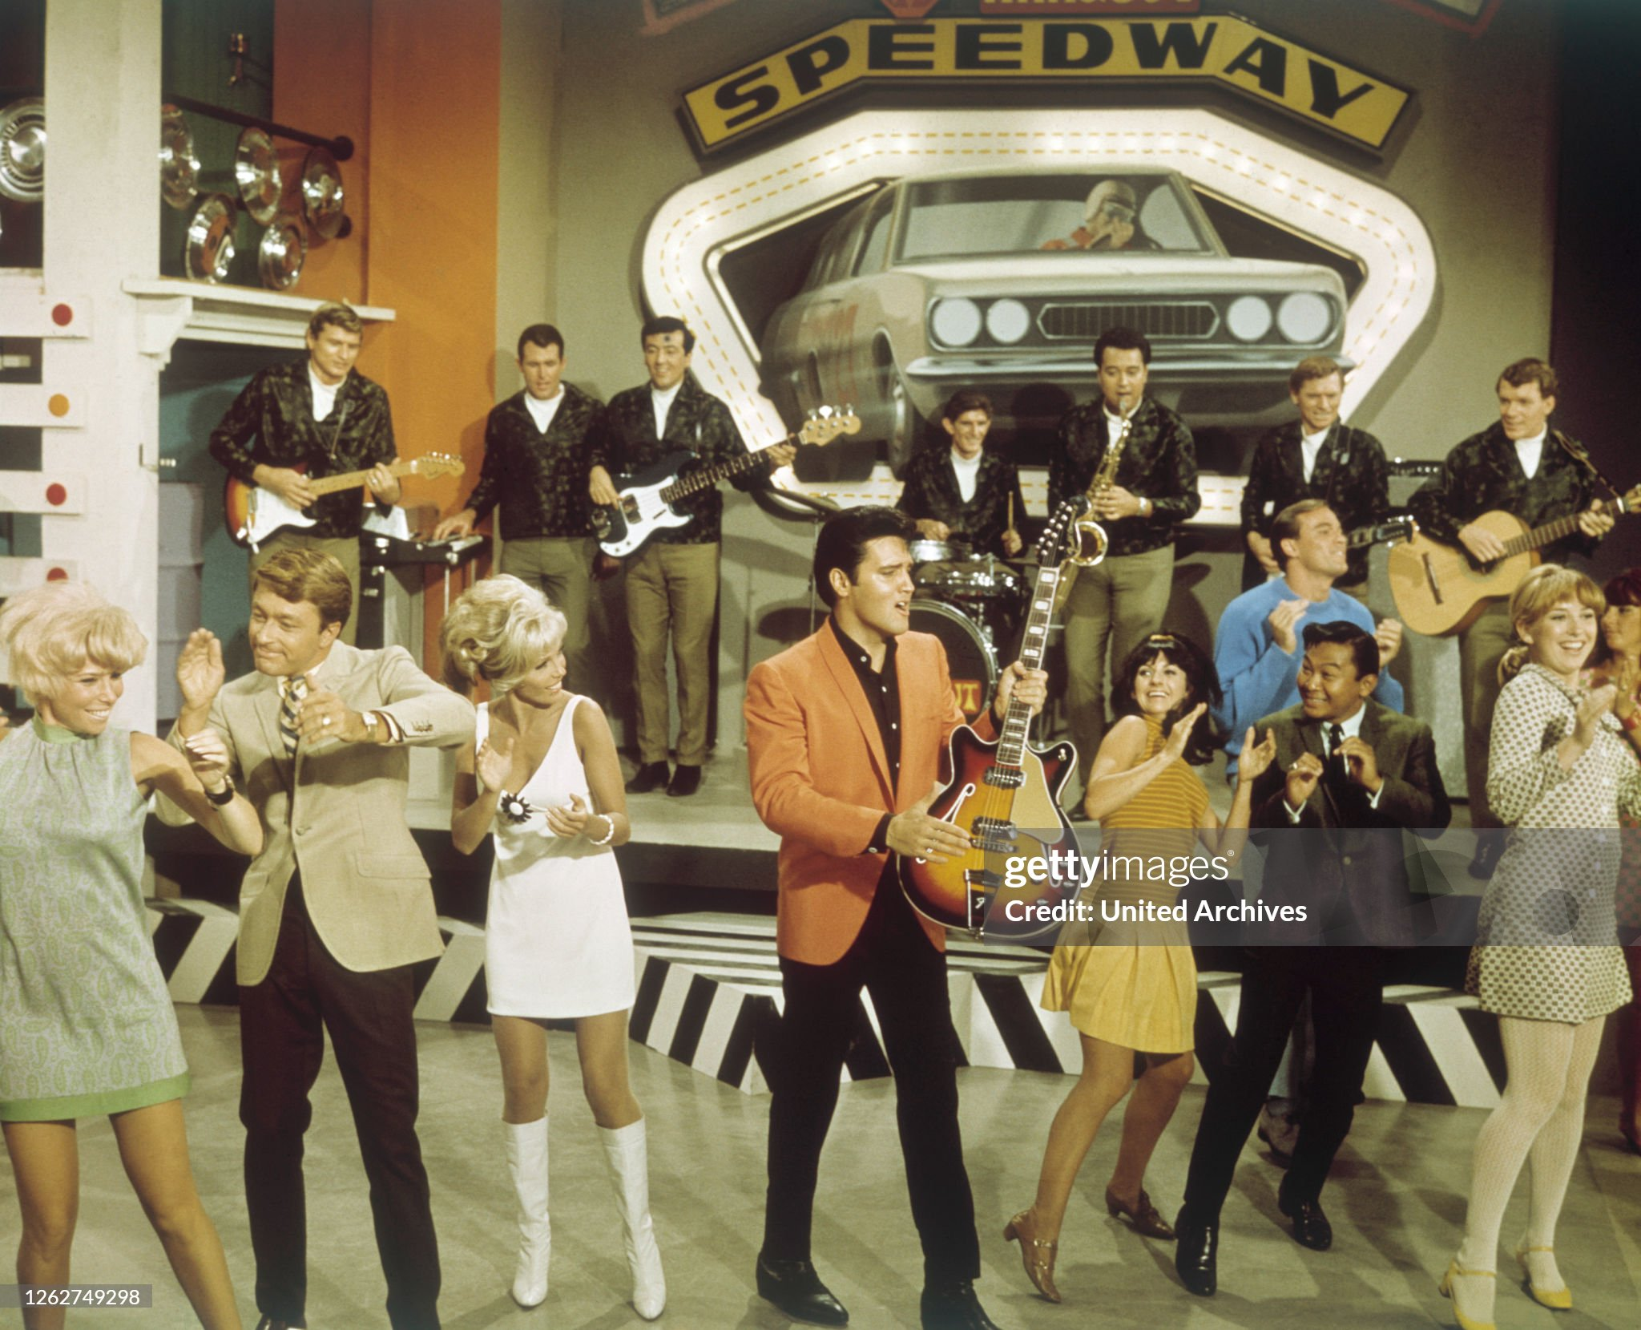
Mini Skirts and Elvis 1965 …neat, bland, innocent, predictable

Slide 6
Tamla Records (Motown)
Legacy of black owned labels
Black Swan Records (1921)—classical and blues
Peacock Record (1949) Gospel music
Vee Jay Records (1953)Rhythm and Blues…released early Beatles to US
Tamla Records founded by Berry Gordy 1959 in Detroit
City booming, 40% black, auto industry centre
Liked name….(Tammy and Batchelor)…soft, catch name
Professionalised acts…focus on cross over appeal
Hit with White audiences
Shift from segregated to integrated audiences
Black music popularised
Crossed to UK..EMI license agreement ….

Slide 7
The Supremes 1965 (in London) ..other hits Mary Wells (My guy)Four Tops ,Temptations, Marvin Gaye, etc
Door open to new sounds, looks….and that was to come from an unexpected place

Slide 8
Arrival of the Beatles February 1964
US in mourning JFK assassination November …in need of joy
US record/ music entirely American acts….British insignificant…Cliff Richard minor star
“Ed Sullivan Show”…biggest weekly entertainment show USA –21 million views
US talent spotter visits UK…reports to Ed Sullivan
Ed Sullivan visits to observer Beatles…unimpressed 1,500 fans at airport greeting Beatles
New music based on talent…missed out on Elvis…Beatles “new thing”
“I want to hold your hand” released by Tamla Motown…January 1964…top of US charts
Why success?
Presentation, simple arrangements, sound different British skiffle mixed with American rock
Humour…irreverent but polite….clean cut….rebellious…but not threatening
“Britishness” welcomed…accents, irreverent
Perfect time, place, behaviour

Slide 9
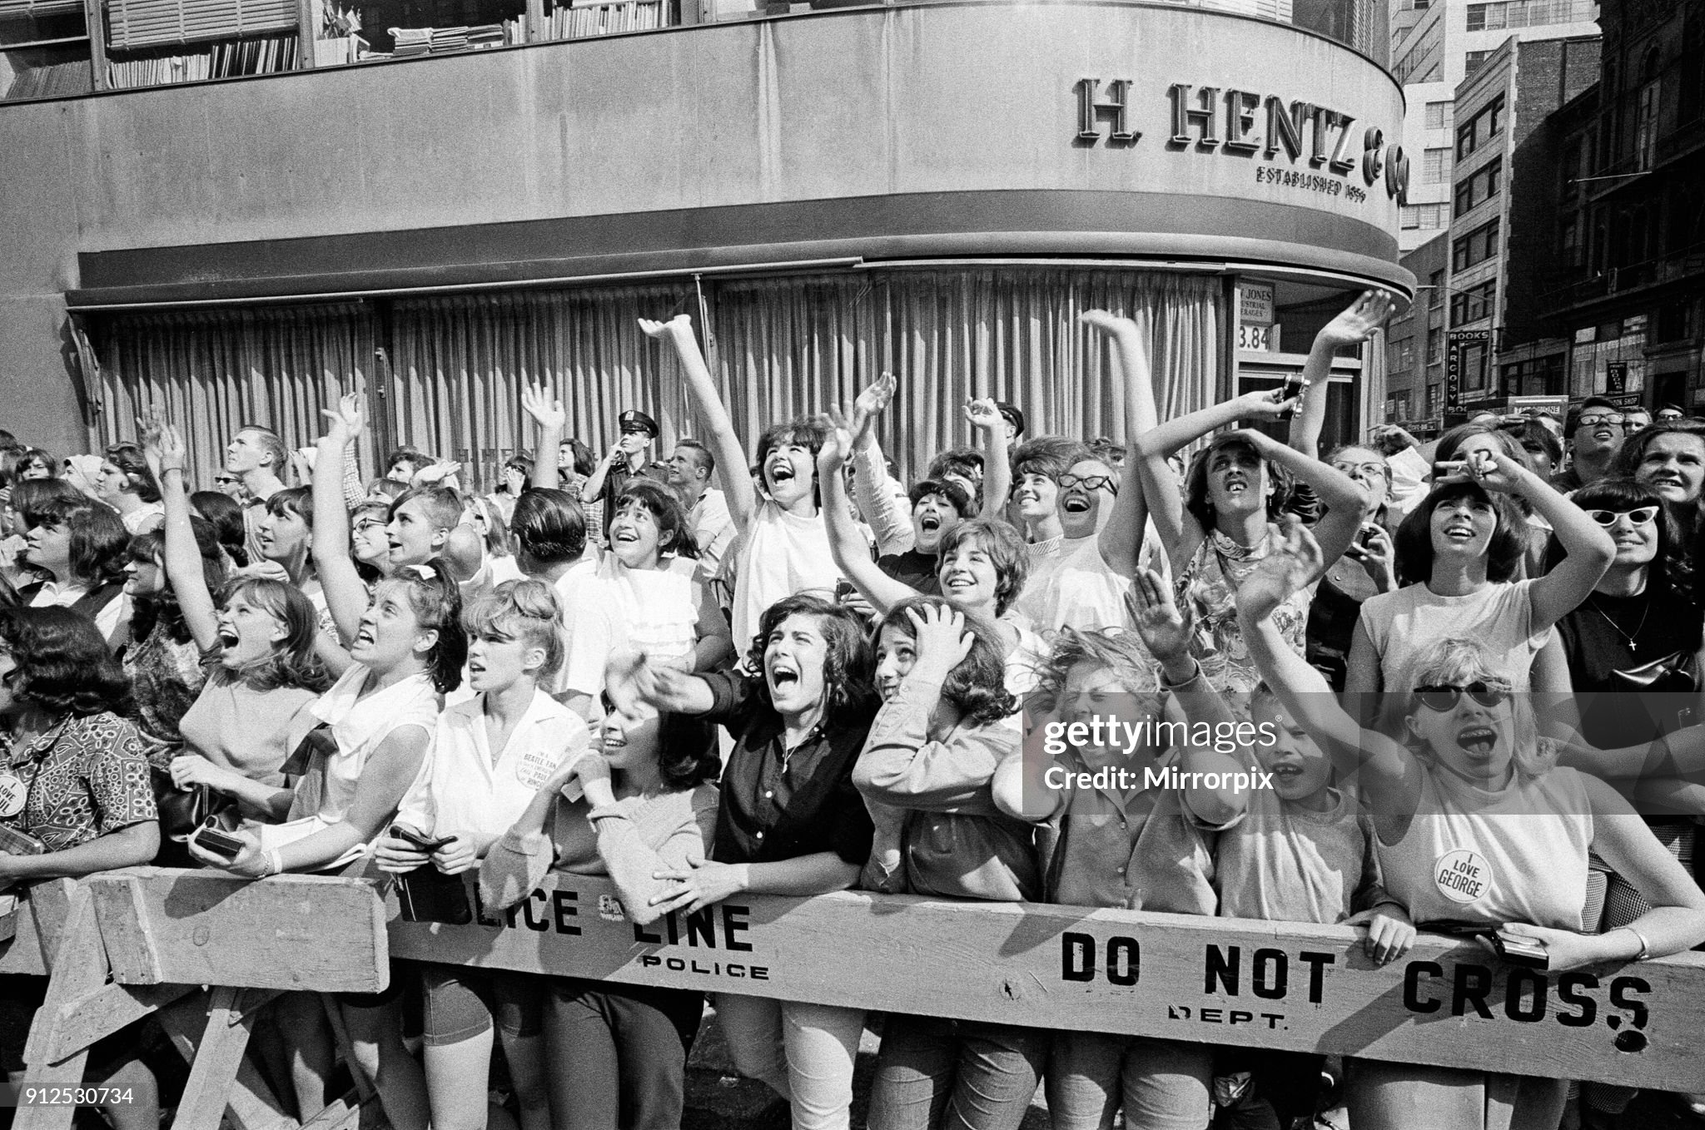
Something big happening @ Beatles arrive …teenagers at New York airport

Slide 10
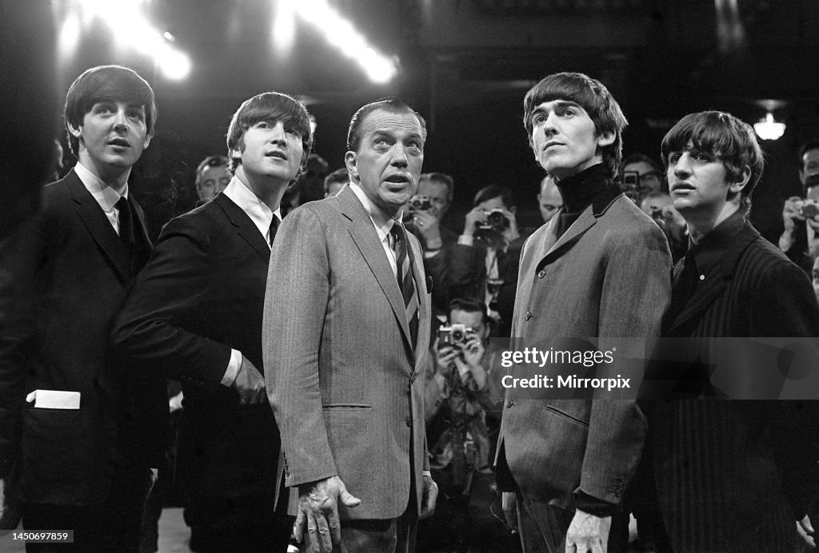
Beatles: Ed Sullivan Show February 1964

Slide 11
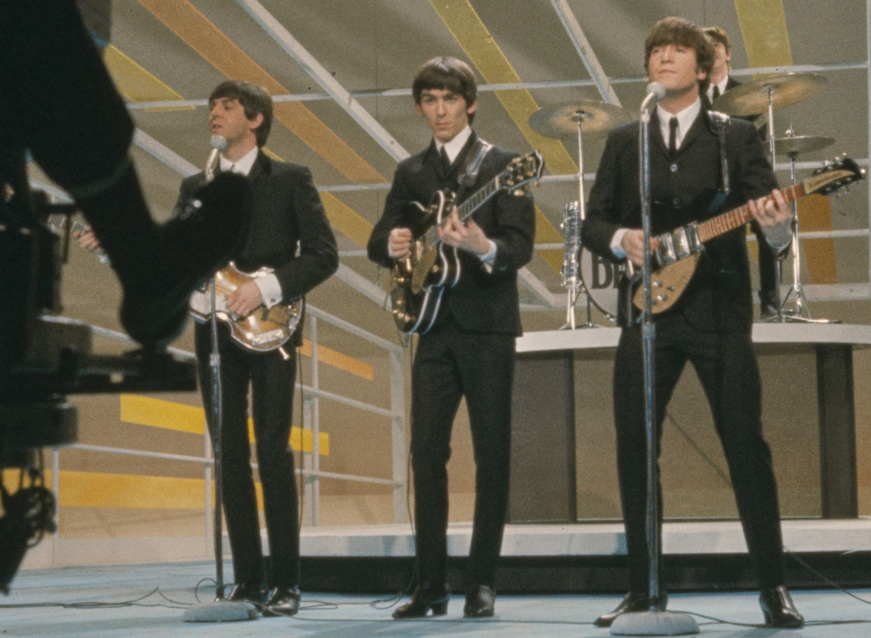
Biggest tv audience to date…73 million viewers

Slide 12
Impact of Beatles
British “Invasion”
Rolling Stones…the “bad boys” June 1964 “I can’t get no satisfaction”
Kinks…. “You really got me”…raw riff driven style
Who… explosive stage presence…power chord
Animals…stark, soulful direct lyrics
Impact
Out clean cut teen idols, girl group
In guitar driven rock, blues influence
Emergence of albums, band as creative source…not lead singers only
New generation of American bands…black and white together
Youth culture celebrated….thing in itself to be promoted

Slide 13
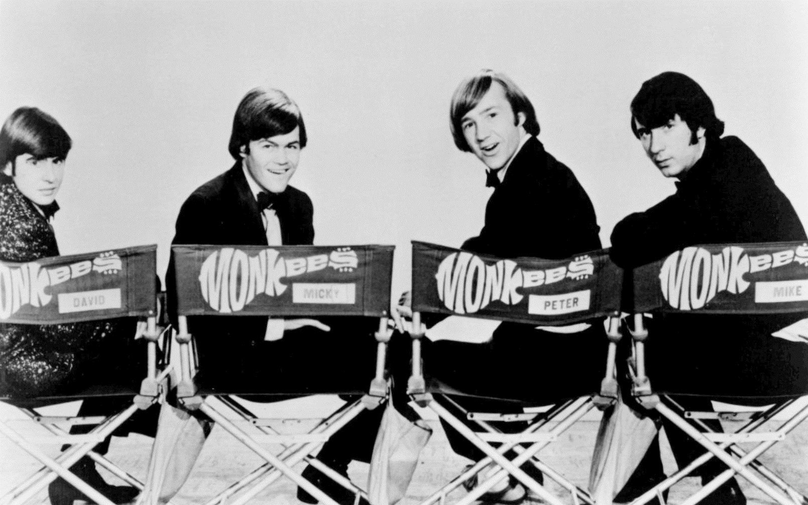
The “Monkees” …manufactured group..dubbed …tv series 1965-1968

Slide 14
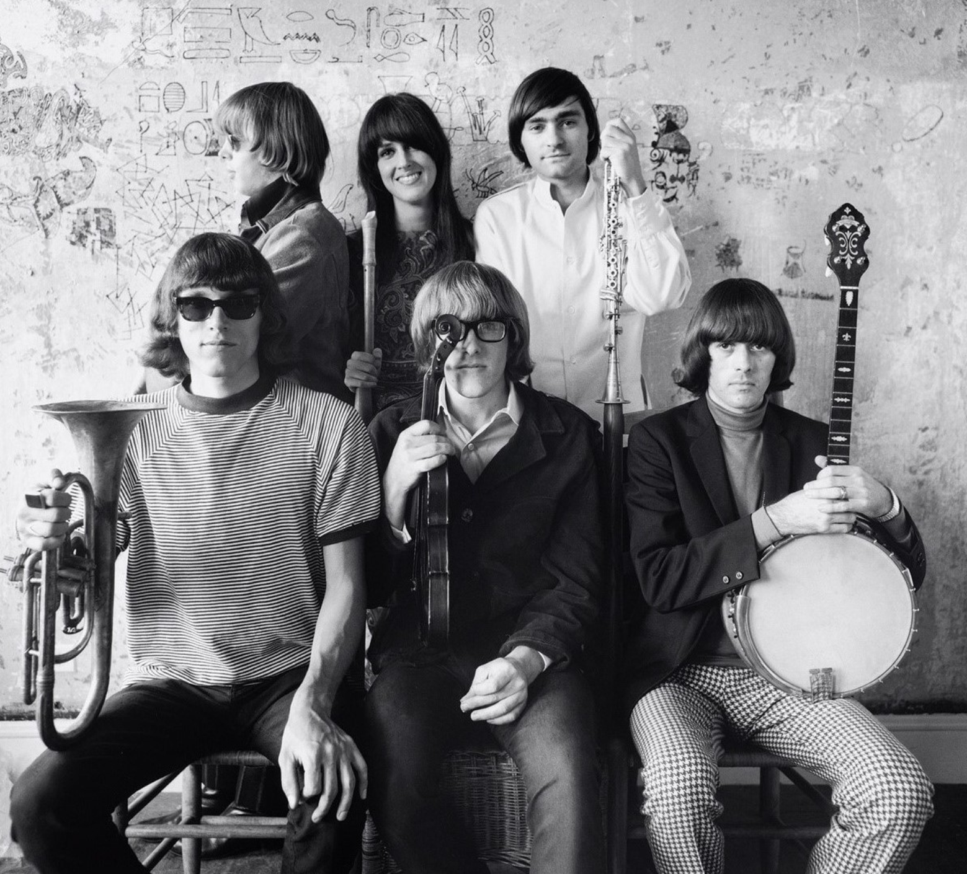
From rock to psychedelic Jefferson Airplane…San Francisco …..surreal “White Rabbit”

Slide 15
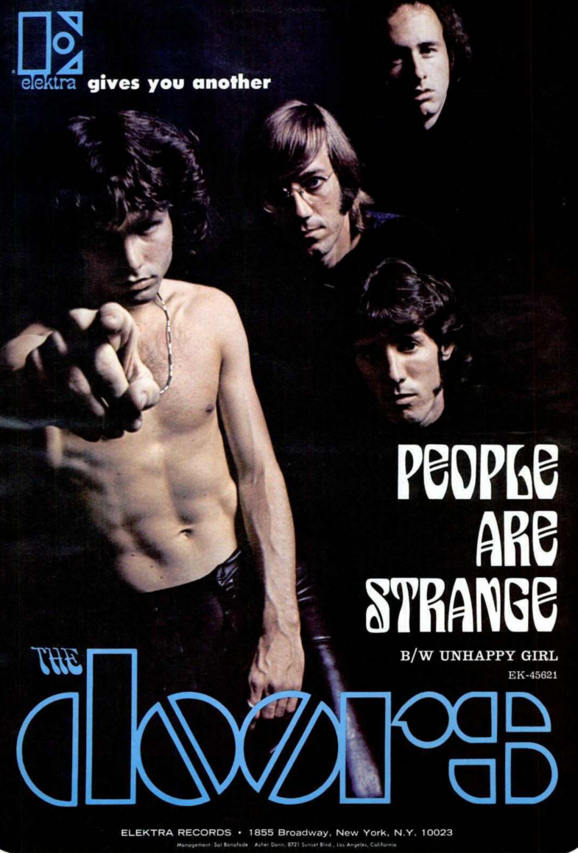
The Doors….concept albums, intense lyrics

Slide 16
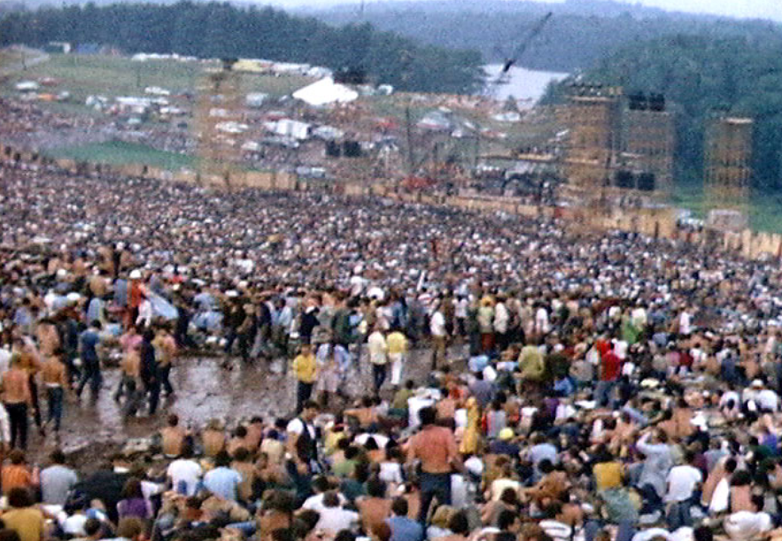
The first rock concerts: largest mass gatherings in US ………..Monterey California 1968, 300,000 …………Woodstock 1969 …..400,000 people

Slide 17
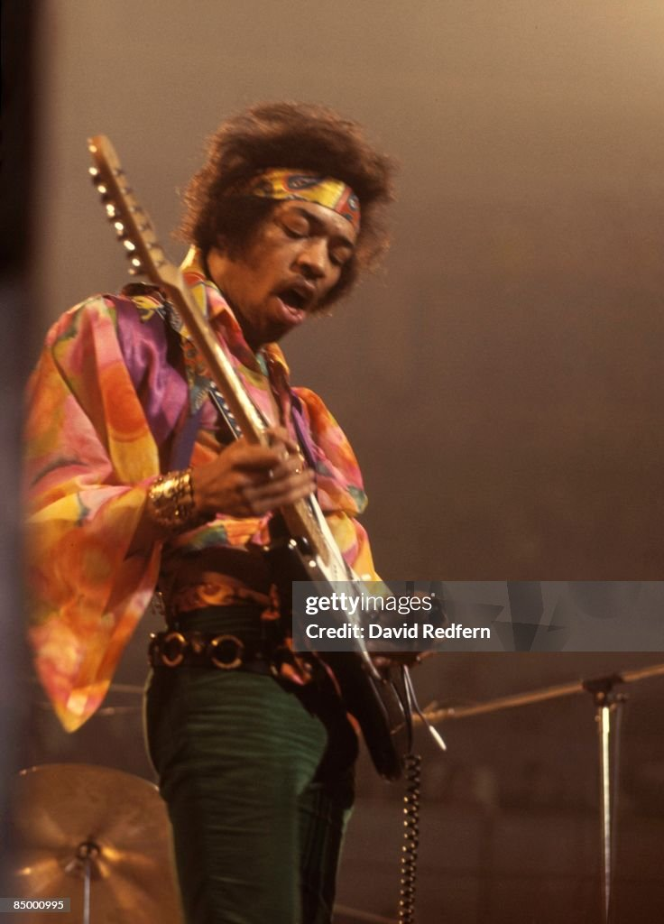
Jimi Hendrix (former US Marine…made famous in UK

Slide 18
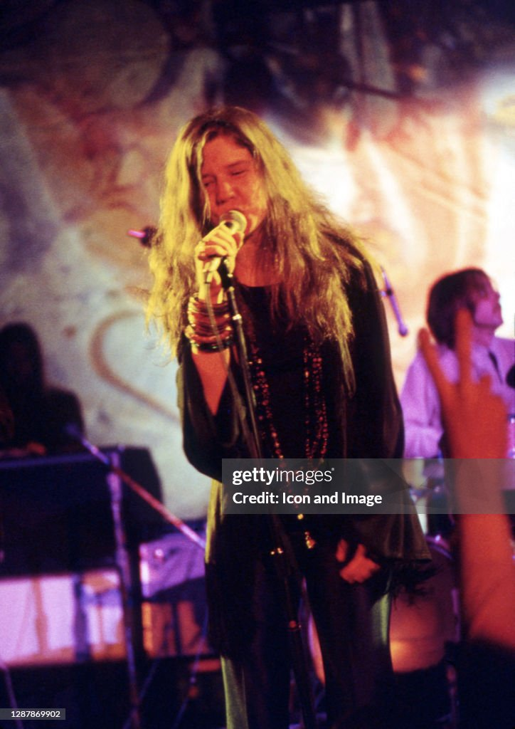
Janis Joplin…wild, emotional, scream song

Slide 19
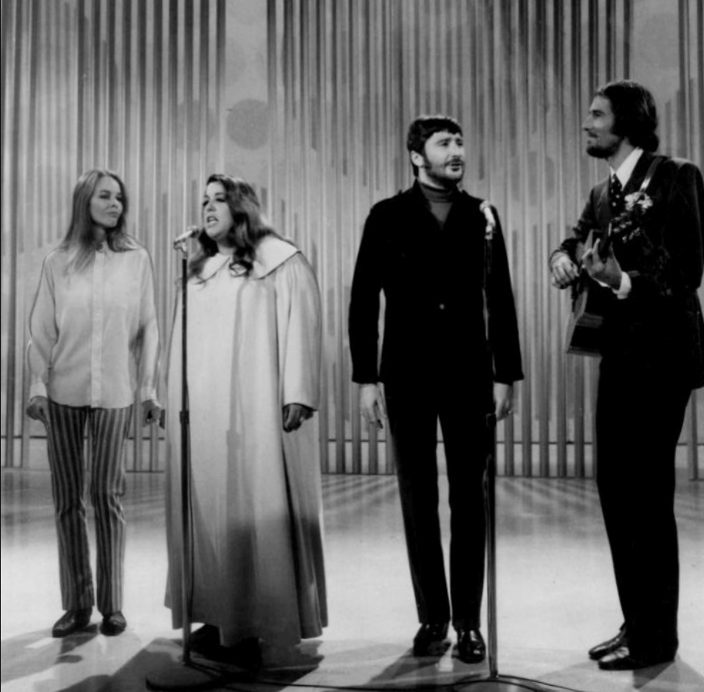
Mommas and Papas

Slide 20
Counter Cultures

Slide 21
USA mid 1960’s
1950’s “Equilibrium” shaken: killing of JFK, real threat of nuclear war
Racial Turmoil: Civil Rights imposed.. resisted, urban riots, growth of black militancy
Social Change
Contraception…liberation of women from childbirth
Demographic bulge….50% increase in teenage population
Mass advertising/ media…instant popularising of trends in music, lifestyle, ……and medication
Growing availability of narcotics….marijuana and LSD
And underlying everything…the growing reality of real war
…. uncertainty about justification…..growing reach of “draft”

Slide 22
Anti War Movement
Early years
High Support for war 60% 1965
First sporadic demonstrations….students/ civil rights/ women's’ movement
Years of Doubt 1966-1967
Increasing conscription…40,000 a month. Deaths at 300 a week ..Life Magazine pictures
“Poor man’s war….middle class/ college escape draft due to deferments
March on New York 300,000….increase across country….and world
Expansion….fusion with Civil Rights 1968-1970
TET offensive …US not winning/ Media transitions to critical…approval reduced to 30%
Moral case for war (execution photo) collapses as US negotiates Peace
Returning veterans ridiculed…many join marches
Mass demonstrations 500,000 march New York….everywhere
Unprecedented…no such mass demonstrations since Civil War

Slide 23
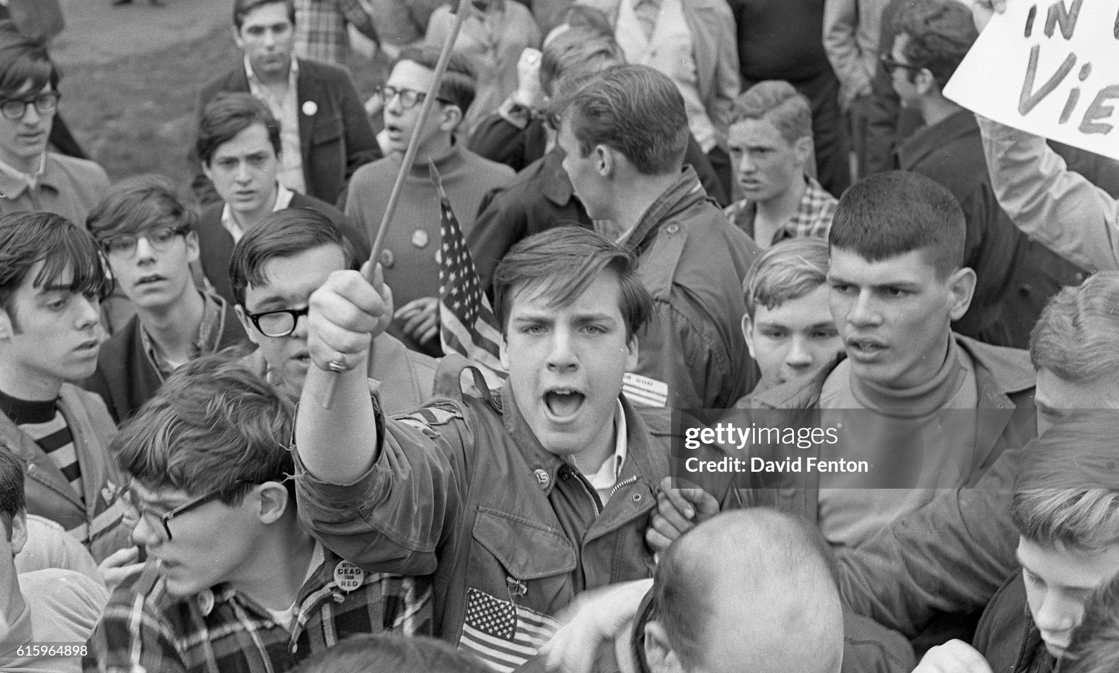
Hawks: war necessary, anti war demos traitors

Slide 24
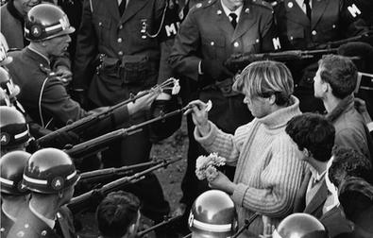
“It is always the young that make the change. You don't get these ideas when you're middle-aged. Young people have daring, creativity, imagination and personal computers. Above all, what you have as young people that's vitally needed to make social change, is impatience. You want it to happen now. There have to be enough people that say, ‘We want it now, in our lifetime.’ This is your moment. This is your opportunity. Be adventurists in the sense of being bold and daring. Be opportunists and seize this opportunity, this moment in history, to go out and save our country. It's your turn now.”
Anti war Movement and Social Transformation
“The picture: flower on guns”
Abbie Hoffman (1936-1989)

Slide 25
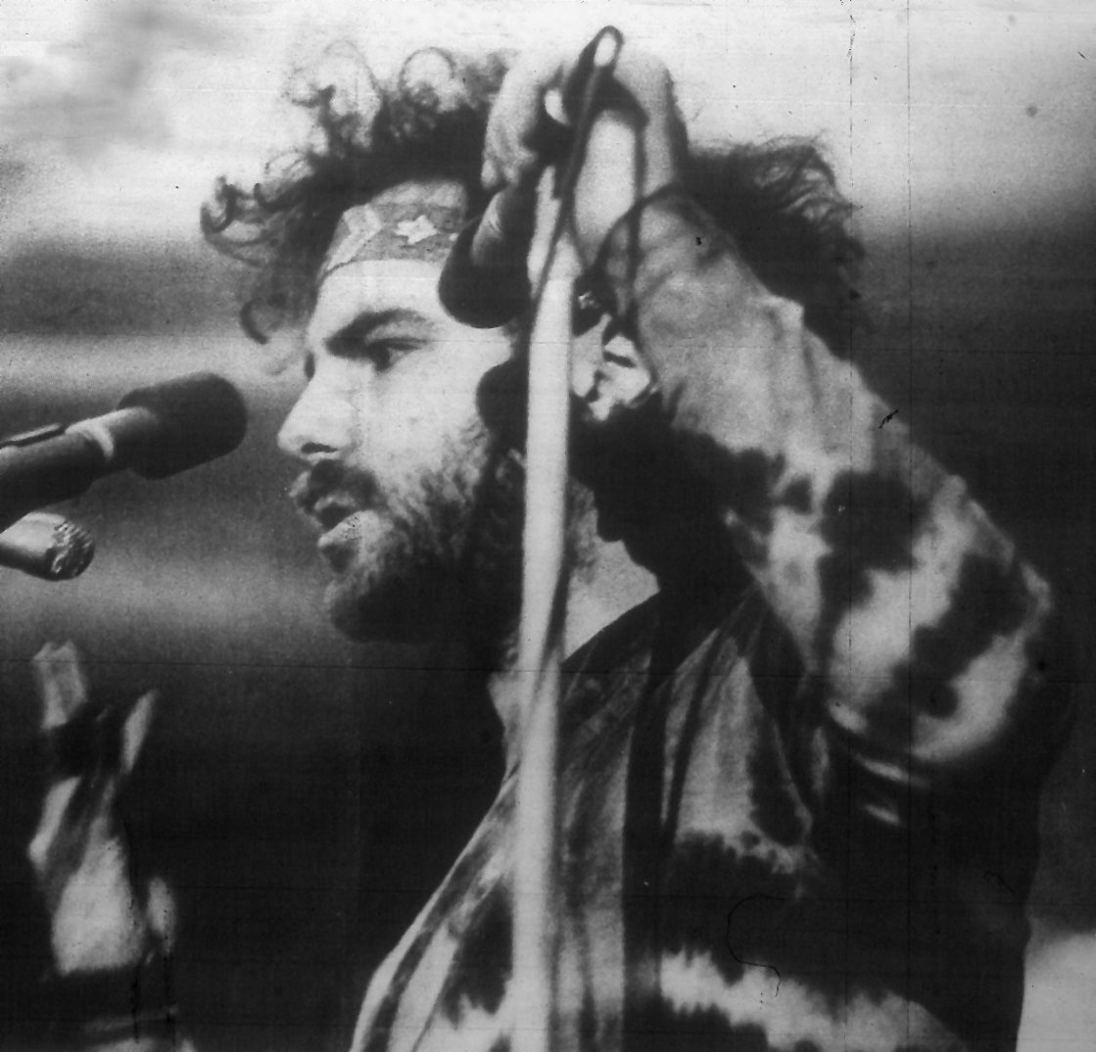
A New America? Jerry Rubin (1938-1994)
Anti war activists
…anti capitalist/ corruption
….anti materialism
…theatrical politics
….Wall Street dollars, flower power
Founds “Yippies”:Youth International
….disorganisation required
….anti capitalist, materialism,
…HUAC appearance as VC
…outrage …was the point
“I am a child of America. If ever I'm
sent to Death Row for my
revolutionary 'crimes, ' I'll order
as my last meal: a hamburger,
French fries, and a coke."

Slide 26
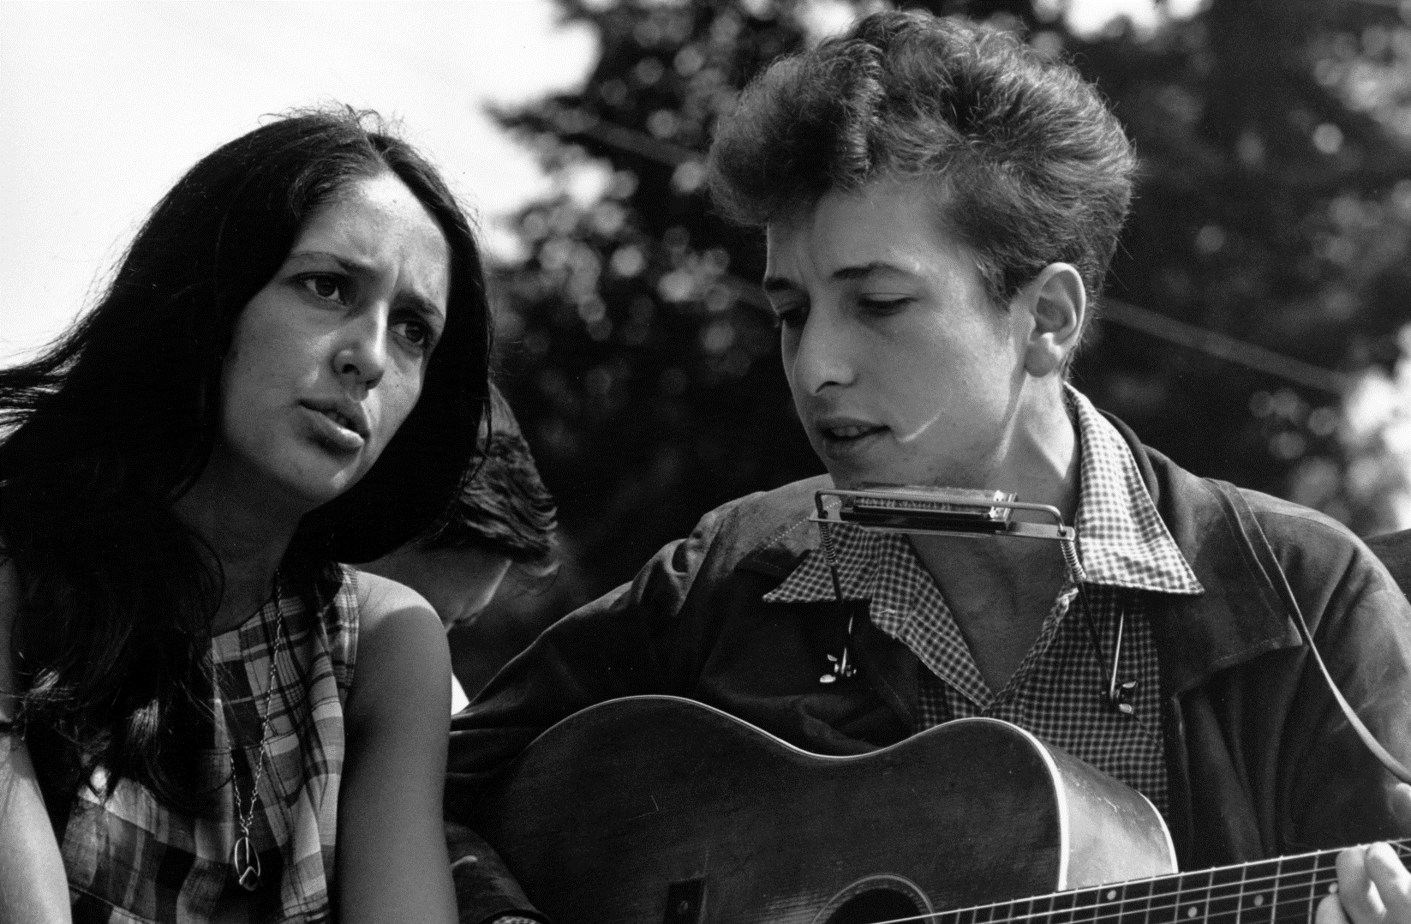
Bob Dylan/ Joan Baez
Bob Dylan (1941…).
Born Robert Zimmerman
… folk musician Early 60’s
..becomes “voice of the Generation”
Folk…protest music
..stream of conscious…apocalyptic
Joan Baez ( 1941….)
Father Mexican (co inventor X
Ray microscope, mother Scot
..Brought up in New York
..moved to California
…popular folk singer
…lover/ populariser Bob Dylan

Slide 27
Bob Dylan: the times they are a changing (1965)
Come gather 'round, people, wherever you roam
And admit that the waters around you have grown
And accept it that soon you'll be drenched to the bone
If your time to you is worth saving
And you better start swimmin' or you'll sink like a stone
For the times, they are a-changin'
[Verse 2]
Come writers and critics who prophesize with your pen
And keep your eyes wide, the chance won't come again
And don't speak too soon, for the wheel's still in spin
And there's no tellin' who that it's namin'
For the loser now will be later to win
For the times, they are a-changin'

Slide 28
[Verse 3]
Come senators, congressmen, please heed the call
Don't stand in the doorway, don't block up the hall
For he that gets hurt will be he who has stalled
The battle outside ragin'
Will soon shake your windows and rattle your walls
For the times, they are a-changin'
[Verse 4]
Come mothers and fathers throughout the land
And don't criticize what you can't understand
Your sons and your daughters are beyond your command
Your old road is rapidly agin'
Please get out of the new one if you can't lend your hand
For the times, they are a-changin'

